Slide 1
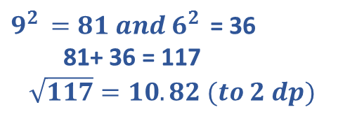
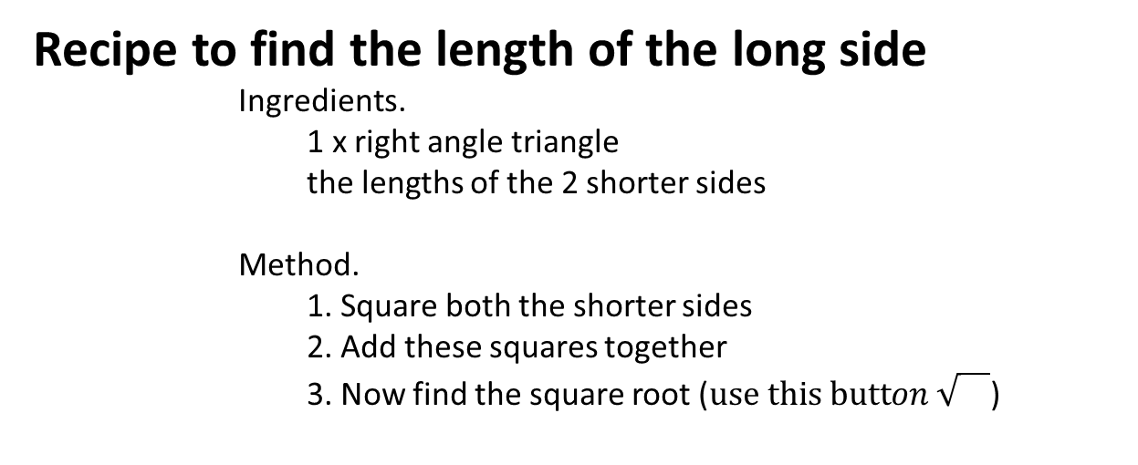
Recipe to find the length of the long side
Ingredients.
1 x right angle triangle
the lengths of the 2 shorter sides
Method.
1. Square both the shorter sides
2. Add these squares together
3. Now find the square root ($use this button \sqrt{}$)
9
$9^{2 }=81 and{ 6}^{2 }$ = 36
81+ 36 = 117
$\sqrt{117}=10.82 (to 2 dp)$
6
Or mathematically we can write Long = $\sqrt{{short}^{2}+ {short}^{2} }$

Slide 2
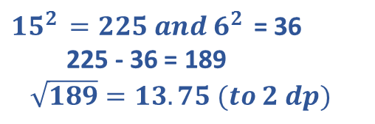
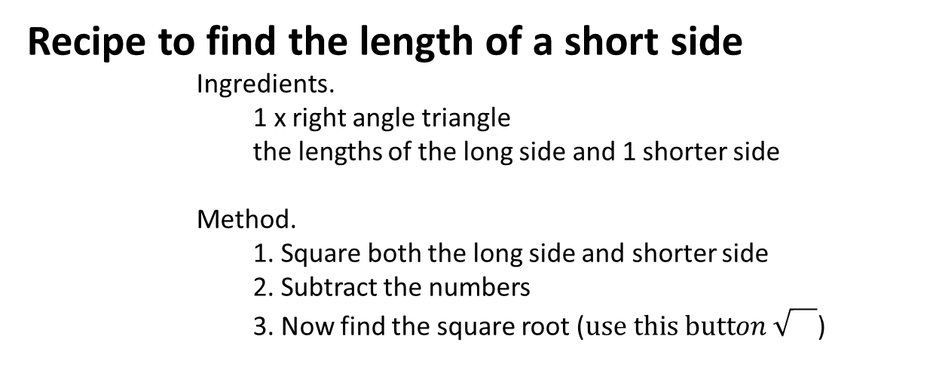
Recipe to find the length of a short side
Ingredients.
1 x right angle triangle
the lengths of the long side and 1 shorter side
Method.
1. Square both the long side and shorter side
2. Subtract the numbers
3. Now find the square root ($use this button \sqrt{}$)
15
${15}^{2 }=225 and{ 6}^{2 }$ = 36
225 - 36 = 189
$\sqrt{189}=13.75 (to 2 dp)$
6
Or mathematically we can write short = $\sqrt{{long}^{2}− {short}^{2} }$

Slide 3
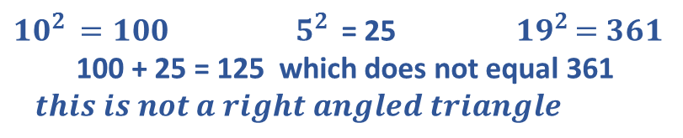
Recipe to use Pythagoras to check if a triangle has a right angle.
Ingredients.
1 x triangle
the lengths of all sides
Method.
1. Square all three sides
2. Add the squares of the 2 short sides together and compare it to the square of the longer side
3. Only if they are the same then it is a right angle triangle
10
19
${10}^{2 }=100{ 5}^{2 }$ = 25 ${ 19}^{2 }=361$
100 + 25 = 125 which does not equal 361
$this is not a right angled triangle$
5

Slide 4
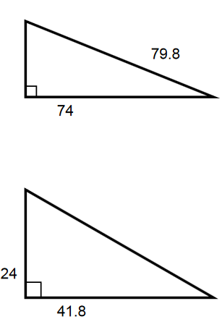
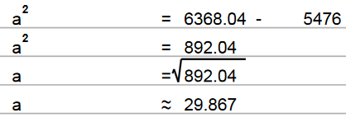
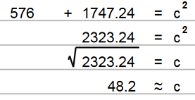
Let’s try

Slide 5
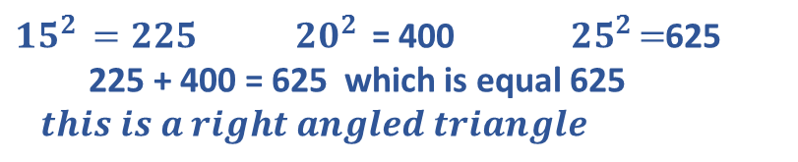
Is this a right angled triangle (according to the measurements not the picture)?
${15}^{2 }=225{ 20}^{2 }$ = 400 ${ 25}^{2 }=$625
225 + 400 = 625 which is equal 625
$this is a right angled triangle$
20
25
15

Slide 6
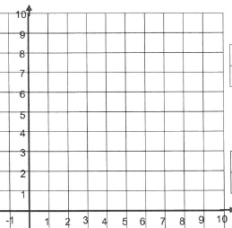
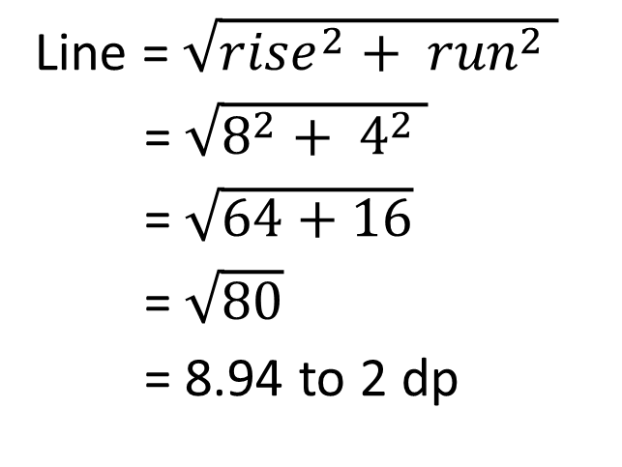
Topic : Pythagoras
24
7
30
Date
EQ : Length of a line on a graph
Line = $\sqrt{{rise}^{2}+ {run}^{2} }$
= $\sqrt{8^{2}+ 4^{2} }$
= $\sqrt{64+16}$
= $\sqrt{80}$
= 8.94 to 2 dp
RISE = 8
RUN = 4

Slide 7
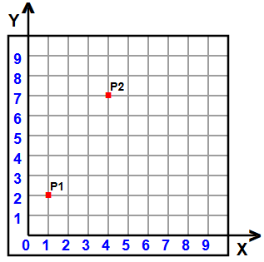
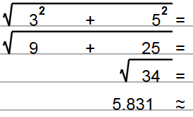
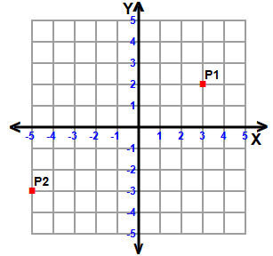
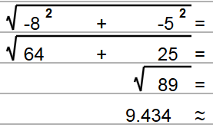
Let’s try these together

